Slide 1
Airport Cybersecurity Quick Guide and assessment tool
National Safe Skies Alliance, Inc.
Program for Applied Research in Airport Security (PARAS) 0007
Presented by: Synergy Solutions, Inc.
Notes:
Airport administration systems and networks have always been tempting targets for hackers and cyber criminals because of their open nature and the necessity that travel information be available to travelers no matter what devices they use.
National Safe Skies Alliance commissioned this project to help airports of all sizes and resources improve their network security.

Slide 2
Purpose of the project
PARAS 0007 Quick Guide for Airport Cybersecurity: Twofold purpose
Produce Cybersecurity Quick Guide document to help airport managers understand and address cybersecurity issues
Develop and implement an easy-to-use tool to help airports of any size determine their level of risk to cyber attack and evaluate the maturity of their current cybersecurity efforts
Notes:
This Safe-Skies-sponsored project was instituted to help airports across the country understand the cybersecurity risks they face, and to evaluate and strengthen their individual cybersecurity programs.
The project called for development of a Cybersecurity Quick Guide document and an accompanying assessment tool that was aimed at airport managers and leadership, not specifically airport IT technical teams.
The project had several fundamental requirements:
The Quick Guide document would provide meaningful and actionable information for airport managers to evaluate and improve their own cybersecurity efforts.
The accompanying assessment tool would measure the airport’s cybersecurity program and would be universally usable by large and small airports without additional software or hardware.

Slide 3
Purpose of the project continued
Cybersecurity Quick Guide
  Discusses cybersecurity concepts in the context of the National Institute of Standards and Technology (NIST) Cybersecurity Framework
  Contains specific questions for airport CEOs/Directors to ask their staff members
  Explains how the Cybersecurity Assessment Tool works
  Gives cybersecurity best practices
Notes:
The Quick Guide Document
Discusses risks faced by airports and the types of attacks and attackers they might encounter
Discusses typical cybersecurity program structure in the context of a government-developed framework (National Institute of Standards and Technology [NIST] Cybersecurity Framework).
Targets general airport management and technical teams as the audience; also contains specific sections aimed at Airport CEOs and Directors, including questions an airport executive should be asking their staff (both airport operations and IT staff)
Explains the functionality and use of the Cybersecurity Assessment Tool in detail
Lists some industry-recognized cybersecurity best practices.

Slide 4
Purpose of the project continued
Assessment Tool
  Designed to be run on common systems found at almost any airport
  Targets airport management teams with help from IT and cybersecurity staff
  Produces ratings for the airports’ cybersecurity program as well as suggested steps to improve in specific areas
Notes:
The Assessment Tool
Designed to run on common systems found at any airport: Microsoft Excel and Microsoft Visual Basic (both part of the basic Microsoft suite of programs)
The tool is meant to be used by a small team of airport operations and IT specialists with some assistance from IT security staff if necessary
The tool produces cybersecurity risk ratings based on the airport operating and governance environment, as well as ratings on the airport’s existing cybersecurity program
The tool also produces suggestions for additional policies, tools, or processes for areas where the airport’s cybersecurity program rating is not satisfactory to management

Slide 5
Project Methodology and approach
The project attempted to incorporate existing best practices and programs
  Included interviews with staff and management at large and small airports
  Reviewed existing regulatory requirements as well as recent cybersecurity incidents involving airports
  Vetted by a variety of airports for their comments and suggestions
Notes:
The project methodology included a review of existing cybersecurity regulations and legislation pertaining to airport operations, research into recent cases where airports were targets of cybercriminals, interviews with management and staff at a variety of airports, and review and vetting of the resultant Quick Guide document and assessment tool by currently-practicing airport managers and their teams.

Slide 6
Why Airport Cybersecurity?
Airports are a prime target of cybercriminals, hacktivists, and nation-state actors
As in the business community, small and medium-sized airports may struggle to adequately protect the networks used to operate and manage the airport and serve passengers
In 2016, an official of the European Aviation Safety Agency stated that aviation systems were being attacked on average over 1,000 times per month.
Notes:
Airports are a prime target of computer hackers and other cyber criminals.
Cybercriminals attack for a variety of reasons, but almost always try to attack the weakest targets (i.e., those with little protection).
Airports are highly visible, and a successful attack on one generates media attention, both locally and globally.
Airports are also symbolic targets for hacktivists and nation-state actors, and if compromised can sometimes lead to other official or government-related network access.
Airports continue to be targeted for attack by cybercriminals, hacktivists, and nation-state actors.
Feb 2017 – Brussels airport website unsuccessfully attacked hours after two suicide bombers struck the airport departures hall. A US teenager confessed to the attack; unrelated to terrorist attack.
Airports in Poland, Vietnam, Ukraine , Japan and in the US were attacked in 2015 and 2016.
As in the business community, small and medium-sized airports may struggle to adequately protect the networks used to operate and manage the airport and serve passengers.
Small and mid-sized airports may have no IT staff dedicated to their operations and little access to cybersecurity expertise.
Resources are often scarce for small and medium airports, and they cannot afford expensive cybersecurity tools or pricey cybersecurity expertise.
It is often hard for airport management to convince outside governing bodies that the airport needs specific cybersecurity programs and measures.
Cybercriminals know that large airports, like large businesses, are more likely than smaller airports to have sophisticated cybersecurity in place; consequently, they will often avoid large airports as targets.

Slide 7
Motivations of Cybercriminals
Monetary gain
Espionage and cyberwar
Media attention
Promotion of a viewpoint or cause (e.g., immigration or environmental issues, US or local politics, current events, etc.)
Entertainment/social inclusion
Notes:
Hackers and cybercriminals often have multiple or hidden motives.
Nation-states will usually attack for espionage or destructive purposes, but have also shown interest in monetary gain when the opportunity presents itself.
Hacktivist groups like Anonymous have also been known to engage in cybercrime activity, and cybercriminals in Russia and China are often tasked by their country’s intelligence agencies to gather information.
Monetary gain – In the past decade, the rise of cybercrime has been alarming. Cybercriminals can become rich with very little risk of being caught by exploiting weaknesses in credit card systems, holding data for ransom, or selling stolen information. Much of the cybercrime for monetary gain currently comes from Russia, Eastern Europe, and the United States.
Espionage and cyberwar activity – Cyberespionage has become a valuable and relatively easy method of intelligence gathering among various nation-states. Several countries—including Russia, China, North Korea, and Iran—have large and active cyberespionage and cyberwarfare capabilities targeting the United States. In addition, al Qaeda and ISIS also leverage cyberattacks to demonstrate their abilities and impress potential recruits.
Gain media attention – Despite the fact that cybercrime is a common occurrence in modern life, actors can garner media attention by conducting an attack against a high-profile target. Attacks can range from website defacement and denial of service attacks on websites and applications, to system compromise in order to steal sensitive documents. A prime example of this has been WikiLeaks’ continual release of material purportedly stolen from the National Security Agency.
Express a viewpoint or support a cause – Some cybercrime is simply undertaken to focus attention on a cause or make a statement. This is particularly true of terrorist groups like ISIS and hacktivist collectives like Anonymous.
Entertainment/social inclusion – Finally, some hackers and cybercriminals, especially young adults, find cybercrime entertaining because it allows them to be part of a community of like-minded people. The cybercrime and hacker communities offer varying levels of structure and hierarchy. Some are very loose and have no real leadership (Anonymous for example). Others are more structured and offer training to new recruits, assignment of specific duties, and sense of common purpose.

Slide 8
Impact to my airport
  Phishing attacks against airport personnel resulting in information theft or network penetration
  Defacement or service interruption to airport websites
  Ransomware attacks encrypting airport files and data
  Theft of sensitive airport documents or emails
  Theft of credit and debit card information from passengers and other visitors
Notes:
Cyberattacks against airports can take many forms and can have impacts that range from minor, annoyance-level website issues to catastrophic service interruption or data corruption. Some common impacts are:
Phishing attacks against airport personnel resulting in information theft or network penetration
Defacement of or service interruption to airport websites
Ransomware attacks encrypting airport files and data
Theft of sensitive airport documents or emails
Theft of credit and debit card information from passengers and other visitors

Slide 9
impact To my airport continued
  Release of airport executive’s personal information, such as home address, email address, family member information, and phone numbers (known as “doxing”)
  Baggage systems disruption
  Attacks on airport electronic signage
  Disruption of airport HVAC systems or other network accessible systems
  Attempts to disrupt airport physical security systems
Notes:
Release of airport executive’s personal information, such as home address, email address, family member information and phone numbers (known as “doxing”)
Baggage systems disruption
Attacks on airport electronic signage
Disruption of airport HVAC systems or other network accessible systems
Attempts to disrupt airport physical security systems

Slide 10
Recent cyberattacks on airports
  In January 2016, the network at the airport in Kiev, Ukraine was penetrated by an attack that appeared to originate in Russia
  In March 2016, an 18-year old in Pittsburgh attempted to take down the Brussels airport website and penetrate the airport network.
  In July 2016, hackers from China attacked two of Vietnam’s largest airports, as well as the website of the Vietnamese airline
  In March 2017, an attack was conducted against Schiphol Airport in Amsterdam by Turkish hacktivists as part of a disagreement between Turkey and the Netherlands.
Notes:
These are all examples of attack against non-US airports, but US airports are also targets
Since 2015, for example, several US airports suffered Distributed Denial of Service (DDOS) attacks from Turkish nationalist actors protesting various perceived slights against Turkey by US and European governments.

Slide 11
Organization of Quick Guide Document
Section 1 – Introduction
Section 2 – For the Airport Executive
Section 3 – Cybersecurity Basics and NIST Cybersecurity Framework
Section 4 – Risk Assessment Tool
Section 5 – Cybersecurity Best Practices
Notes:
To help airport executives and staff better identify the risks to their airports and area where their cybersecurity efforts might be improved, a Quick Guide to Airport Cybersecurity was developed. The Quick Guide is organized into five sections discussing cybersecurity basics, cybersecurity program organization, best practices, and the use of the risk assessment tool that accompanies the document.
Section 1 – Introduction: Discusses the project charter, methodology, and target audience
Section 2 – For the Airport Executive: Contains specific advice and information for CEO or Director level executives
Cyber Risk Management
Discussion about the threats to airports
Description of the kinds of attacks and impacts airports might experience if successfully attacked
Section 3 – Cybersecurity Basics and the NIST Cybersecurity Framework
Description of the NIST Cybersecurity Framework components and organization
Discussion about each section of the framework and how it translates to a cybersecurity program in operation
Section 4 – The Risk Assessment Tool
Description of the organization and operations of the cybersecurity risk assessment tool that accompanies the Quick Guide
Description of the reporting from both the risk assessment and cybersecurity program maturity assessment portions of the assessment tool
Section 5 – Cybersecurity Best Practices
Discussion of some best practices in cybersecurity programs
Appendix D contains a list of questions an airport CEO or director should ask his/her staff to gain insight into the airport’s cybersecurity program.
Appendix E contains project team observations about the state of airport cybersecurity gained through interviews conducted as part of the project.

Slide 12
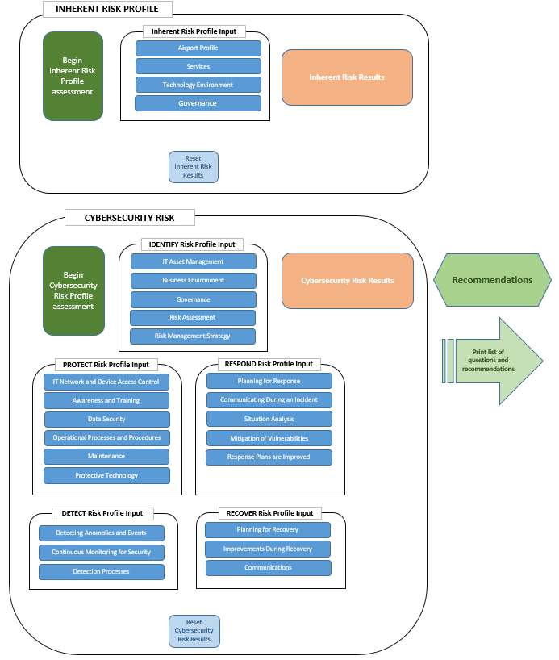
Organization of Assessment Tool
Notes:
The Cyber Assessment tool is organized into two sections:
The Inherent Risk Profile section determines the level of cyber risk an airport has as a result of the environment in which it operates and the services it offers to customers
The Cybersecurity Maturity section measures the airport’s cybersecurity efforts and offers suggestions on how the airport can improve its program based on the answers to the assessment questions
The tool is designed to allow a small team of airport staff in operations and IT to answer simple questions about various aspects of a cybersecurity program
The two sections operate independently of each other, but it is usually better to complete the Inherent Risk Profile before moving on to the Cybersecurity Maturity portion

Slide 13
Organization of Risk profile section
Notes:
The Risk Profile section measures risk in four categories: the airport’s operating profile, the services the airport offers, the airport’s technology environment, and the airport’s policy and oversight environment (its “governance” environment in the tool).
Because the tool retains answers after a session is completed, a team preparing to complete the risk profile section should first reset the results by clicking on the blue button. This clears out any previous answers.
The assessment is started by clicking on the green “Begin the Inherent Risk Profile Assessment” button.

Slide 14
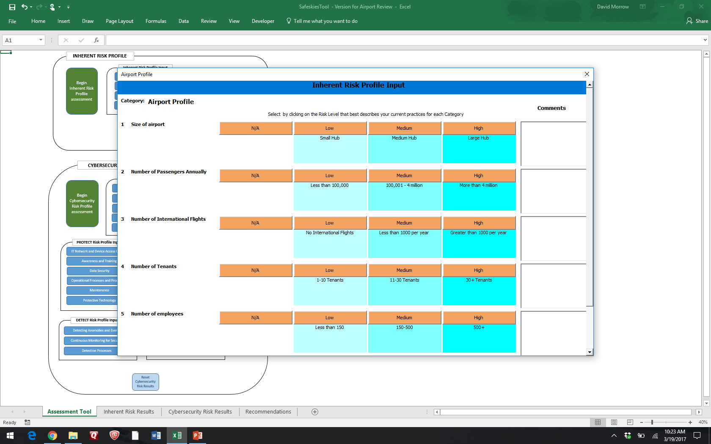
Airport Inherent Risk Assessment
Notes:
When the Inherent Risk Profile section is started, the airport team is presented with a series of descriptive questions regarding the airport and its operations.

Slide 15
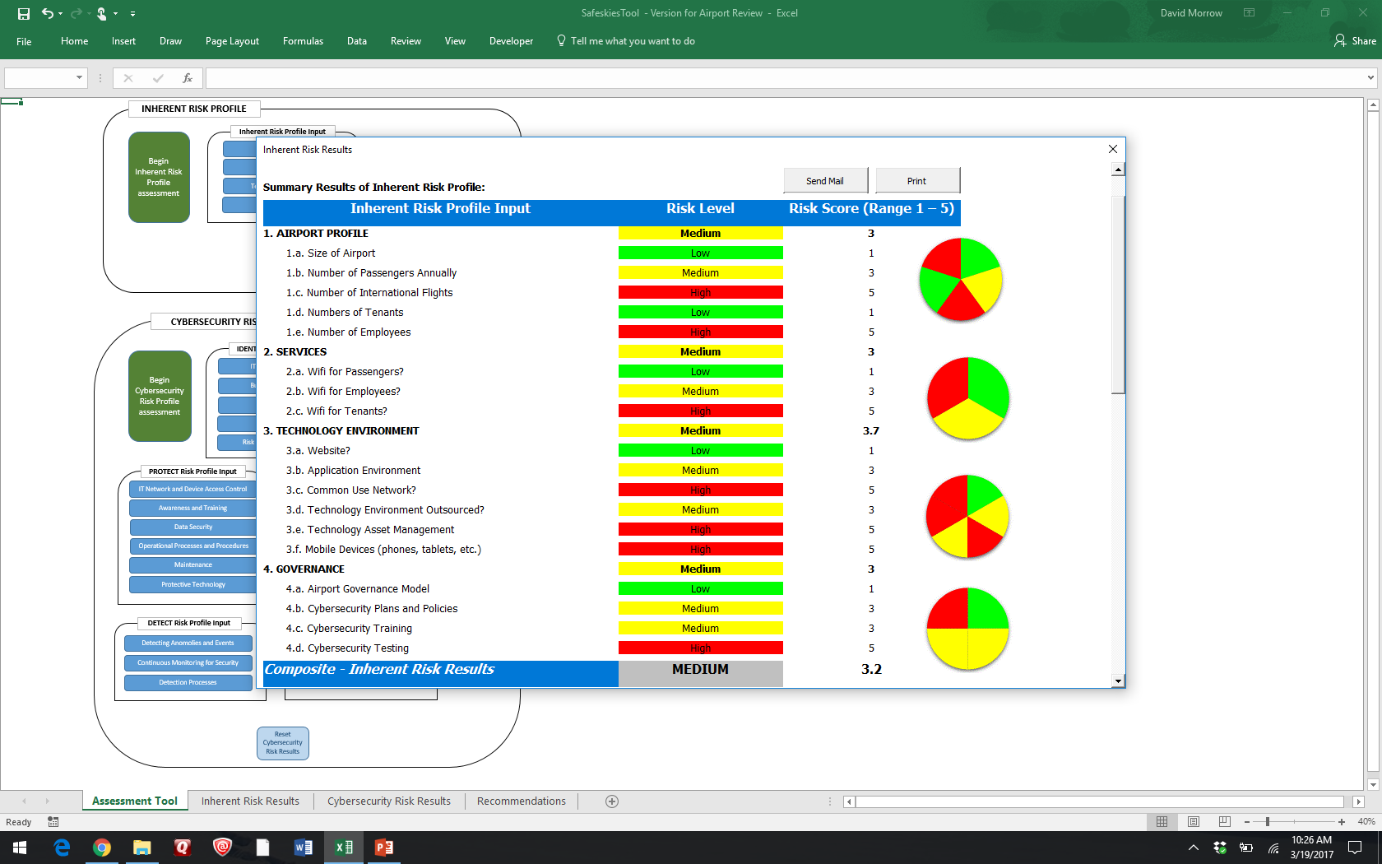
Risk Assessment Reporting
Notes:
The results of the risk assessment are reported as a series of Low, Medium, or High ratings, representing the level of risk for each section of the airport based on the answers to the assessment questions. Summary results for each section are also represented by color-coded pie charts.

Slide 16
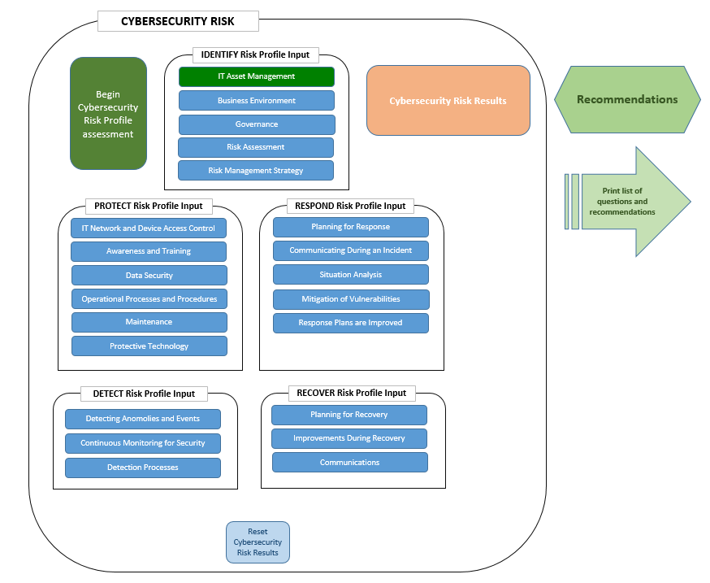
Organization of Cybersecurity Program Maturity section
Notes:
The cybersecurity program maturity section of the tool measures the maturity of the airport’s cybersecurity efforts against the NIST Cybersecurity Framework (CSF) using the 5 sections and 22 categories outlined in the CSF.

Slide 17
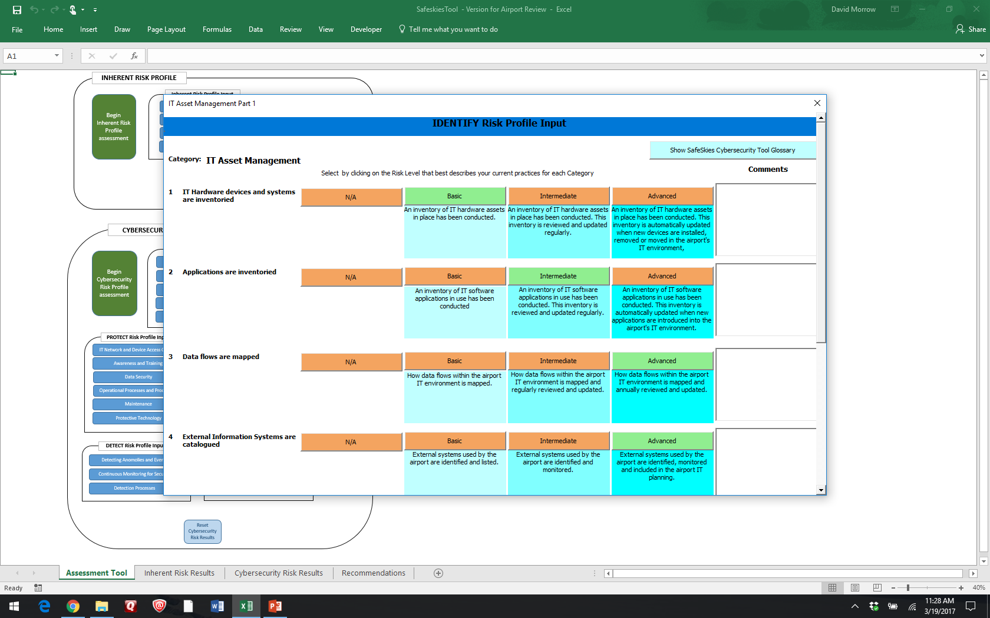
Cybersecurity Program Maturity Assessment
Notes:
The individual or team taking the assessment answers a series of questions related to the airport’s cybersecurity program. The tool is designed to be completed by a small team of airport staff (NOT the airport CEO/Director or executives).

Slide 18
Cybersecurity Program Maturity Assessment
Notes:
Since cybersecurity terms are often unfamiliar to non-security people, a glossary of terms can be accessed at any time while completing the assessment by clicking the button in the top right corner of the screen.

Slide 19
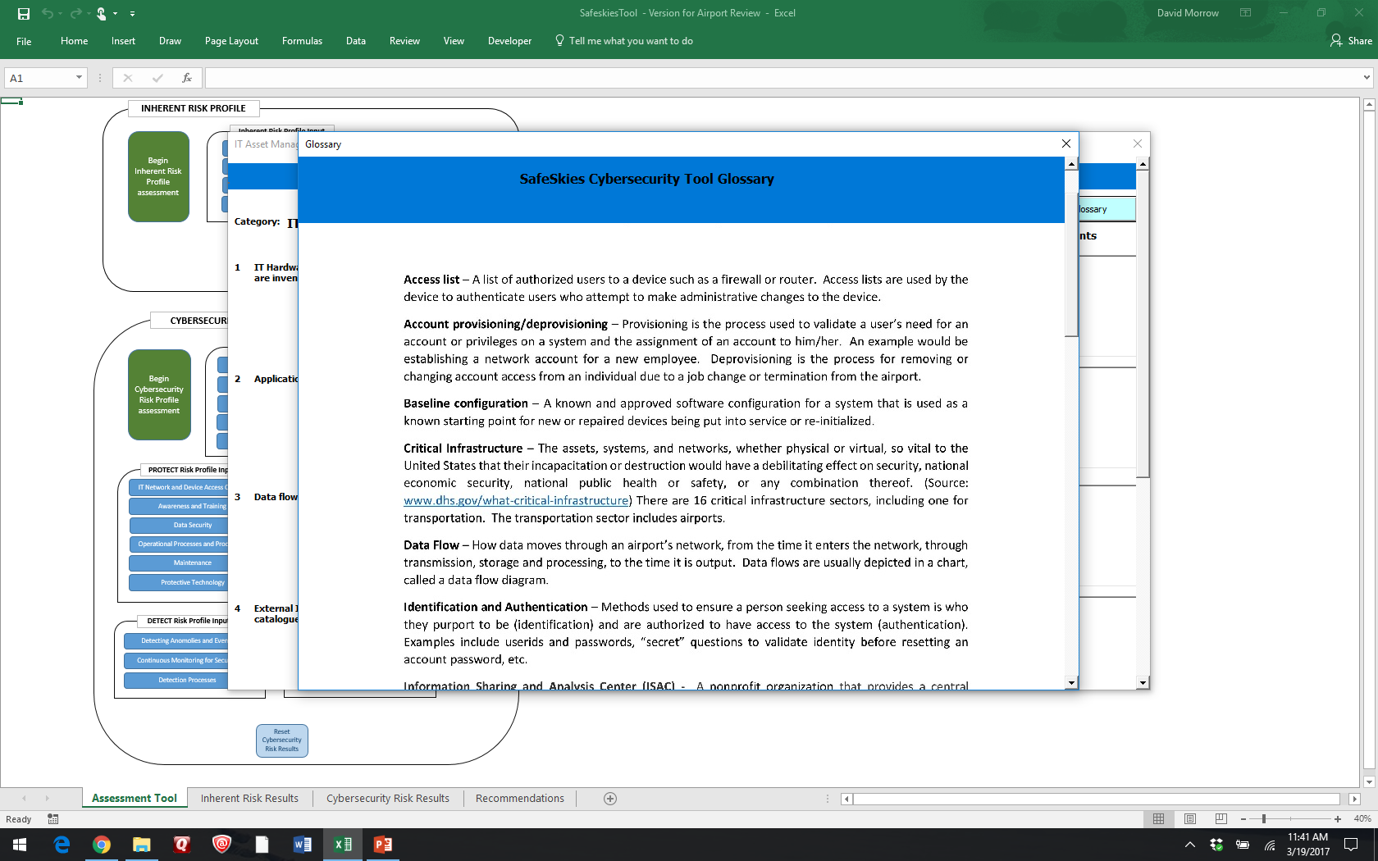
Glossary of cybersecurity terms
Notes:
The glossary contains definitions of terms and concepts in cybersecurity that help individuals understand specialized terminology they may encounter in the tool or the accompanying Quick Guide.

Slide 20
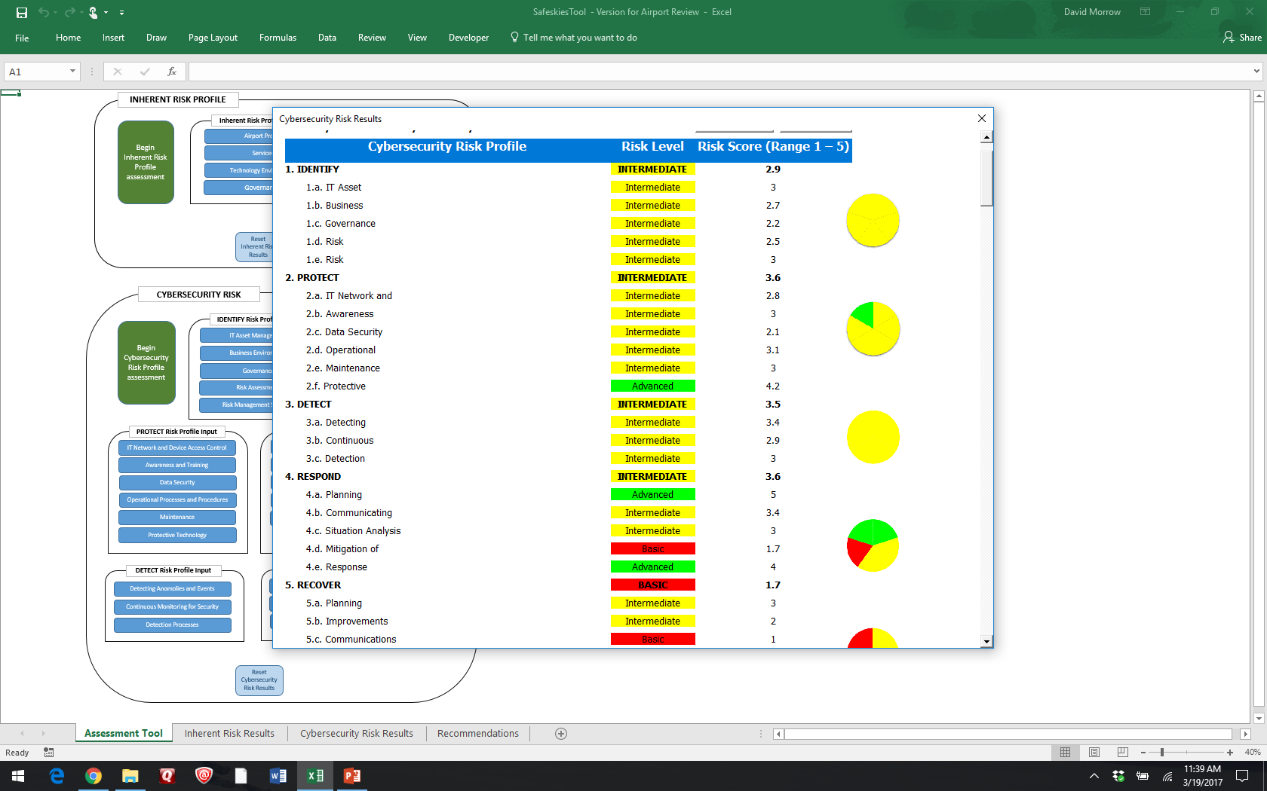
Program Maturity Reporting
Notes:
The assessment tool categorizes the airport’s cybersecurity program maturity into three levels: Basic, Intermediate, and Advanced. Each of the 22 categories within the NIST CSF are rated, as are the five overall risk profile categories that make up the NIST CSF.
The results of the tool are color-coded (Red=Basic, Yellow=Intermediate, Green=Advanced), and pie charts show the distribution of the ratings in each of the 22 categories of the NIST CSF.

Slide 21
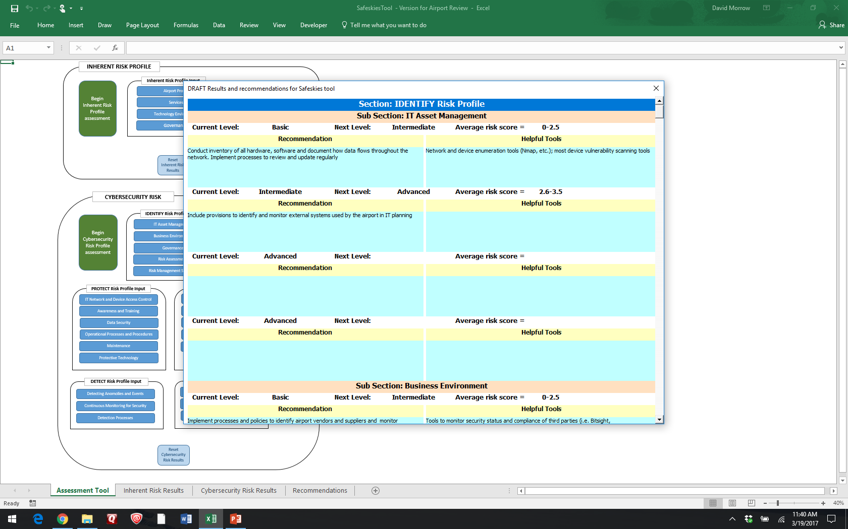
Recommendations for Improvement
Notes:
Finally, the tool produces a set of recommendations that an airport can use to move from their current state to an improved maturity level. All reports from the tool can be printed or exported to Excel or another application.

Slide 22
Using Quick Guide Document & Tool
Read the Quick Guide and familiarize yourself with the Assessment Tool
Airport CEO/Director material in Section 2 and Appendixes C & E of the Quick Guide will help senior executives focus their questions
Assessment tool is designed for airport operations and IT team to complete, not executives
Notes:
Read the Quick Guide and familiarize yourself with the Assessment Tool
Although you can use the tool without reading the Quick Guide first, the document will help familiarize you with cybersecurity concepts and how the tool operates.
Airport CEO/Director material in Section 2 and Appendixes C and E of the Quick Guide will help senior executives focus their questions
The Quick Guide is meant to be accessible to both airport staff and senior executives, but executives may not have either the time or the inclination to read the entire document. Section 2 is specifically written to be of use to senior executives.
Assessment tool designed for airport operations and IT team to complete
While executives might find the tool interesting or need to be consulted on specific questions in the tool, it is not meant to be an executive-level resource.
The target audience for the tool, like the Quick Guide document, is airport staff members

Slide 23
Using Quick Guide Document & Tool continued
Spend some time up front to gather data to make filling out the tool quicker and easier
The exact process is up to you
  Divide the tool into sections and have appropriate staffers complete them
  Designate one or two people to gather data and complete the tool
  Complete tool as a group effort of several IT, IT security, and airport operations experts
Use the tool reporting and materials in the Guide document as basis for a hard look at your own cybersecurity risk and program
Notes:
Spending some time up front to gather data will make filling out the tool quicker and easier
The tool measures a wide variety of factors, and no team is expected to answer all of the questions without some research. Gathering data on your current cybersecurity program, documents and plans, and information about your airport environment will speed the process of operating the tool significantly.
The exact process you use to complete the tool is entirely up to you. Each airport may approach the tool differently. Some common ways to complete the tool would be:
Divide the tool into sections and have appropriate staffers complete them
Designate one or two people to gather data and complete the tool
Complete the tool as a group effort of several IT, IT security, and airport operations experts
Use the tool reporting and materials in the Guide document as basis for a hard look at your own cybersecurity risk and program
The tool is merely a structured way for you to evaluate your airport’s cybersecurity program. It will be the first step in a continual improvement program of cybersecurity for your airport.

Slide 24
wrap up
Quick Guide and Cybersecurity Assessment tool were developed to be applicable to airports of all sizes
Quick Guide provides cybersecurity program basics, specifics for airport CEO/Directors, and detailed instructions for using the tool
Cybersecurity Assessment tool allows a small team of airport staff members to quickly develop profiles of the airport’s cybersecurity risk and the state of its cybersecurity program

